Slide 1


World Population Demographics
Presentation by:
Dinesh Chandra Gaddam
Ganesh Kumar Boini

Slide 2
Content:
Global population growth is a critical issue influencing economics, urbanization
and resource planning. Here we..
List objectives:
Answer questions while Examining historical trends in global population distribution.
Identify regions with the abnormal changes for each question.
Predict future population dynamics and their implications.

Slide 3
Research Questions 1.Population growth trends for individual countries over time? 2.How are the country population divided and how are these division dominances effect the country at its level?
3. How do population demographics, such as gender ratio and birth estimates, vary across different countries and over time?
4.How do birth and death rates impact population growth, and what are the economic implications for countries with varying dependency ratios?

Slide 4
Data Source
Link: Data Source
Data collected from global organizations like the United Nations and World Bank.
Includes population counts by year, country and region grouped age-wise population from 1950 to 2021.
Data is Reliable and standardized for international comparisons.

Slide 5
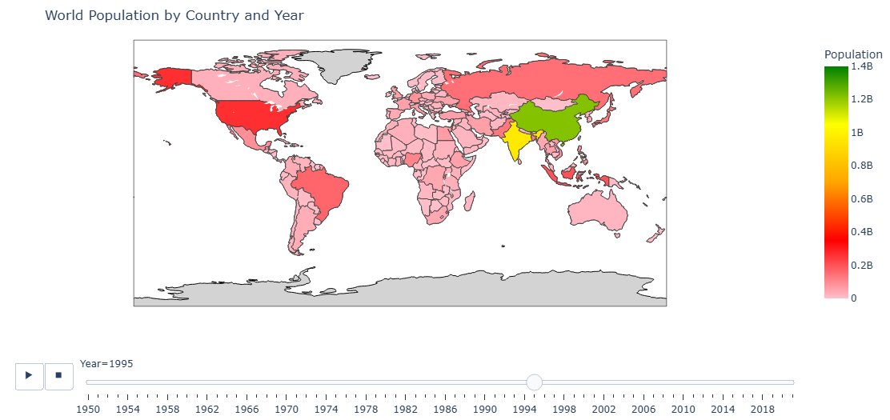
1: Population growth trends for individual countries over time ​ The Map provides the concentration of population around the globe for the year 2021 and
the scale measures upto 1.4 Billion, which is the population of China, India each.,
Code-File link
​

Slide 6
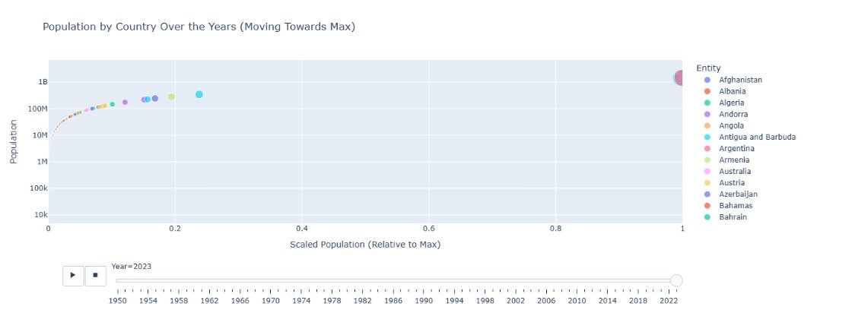
1: Relative Population comparision with China
​ ​​ ​​
​​The plot compares growth of population over the years with the highest populated country- China. ​
​
​
​
​
​
​
​
​
​
​
​
​
​
​
​
​
​
Notes:
We can observe the movement as they come close to the scale of China and India. The graph seems cluttered at some point between 30M-100M.

Slide 7
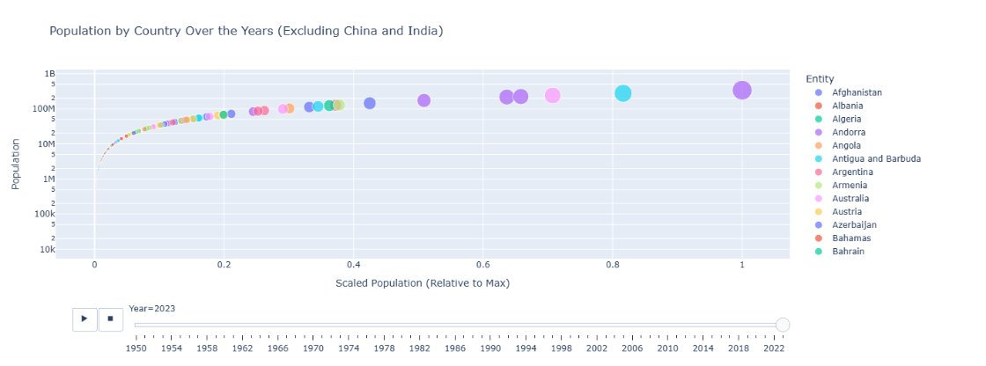
1: Relative Population comparision without India and China
Since the graph had Bunching at millions I have tried removing India and China to observe the characteristics clearly

Slide 8
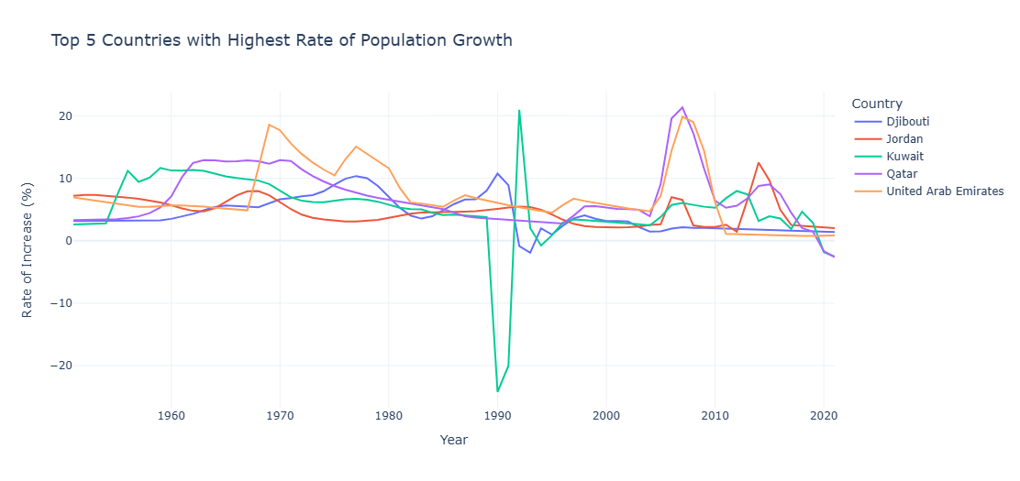
Notes:
Reason: High Adult Population, we will address this in next question- (2), with references. On gulf migration.

Slide 9
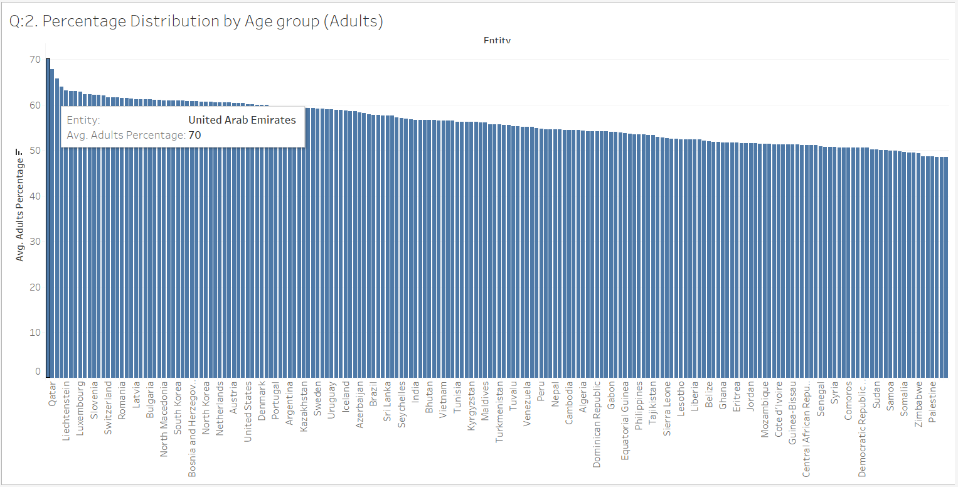
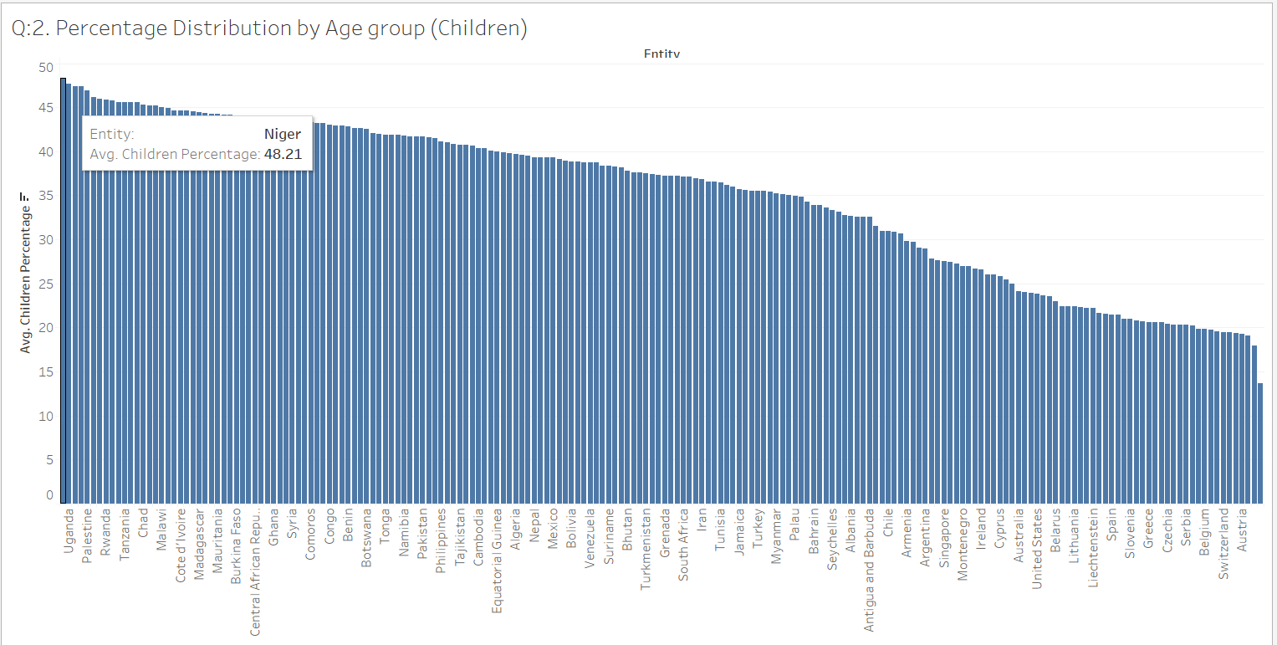
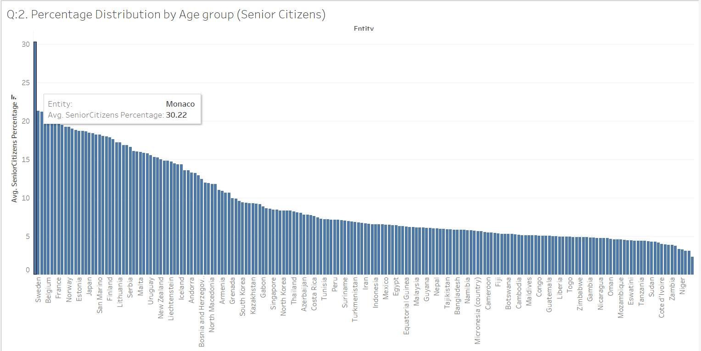
2. How are the country population divided and how are these division dominances effect the country at its level?

Slide 10
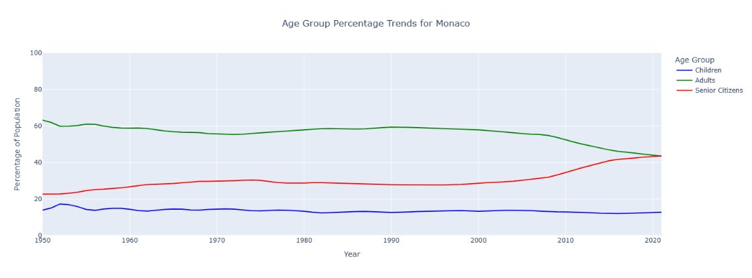
Monaco and Similar Countries (Sweden, UK):
Characteristics: High percentage of senior citizens w.r.t other countries in comparision.
Effects: Aging populations increase pressure on resources like healthcare and pension systems.
Transition and Fall
Notes:
Monaco and Similar Countries (Sweden, UK):
Characteristics: High percentage of senior citizens, low percentage of children, and a moderately high adult population.
Effects:
Aging populations increase pressure on healthcare and pension systems.
Economic growth may rely on highly skilled labor or burden immigrants to maintain economy

Slide 11
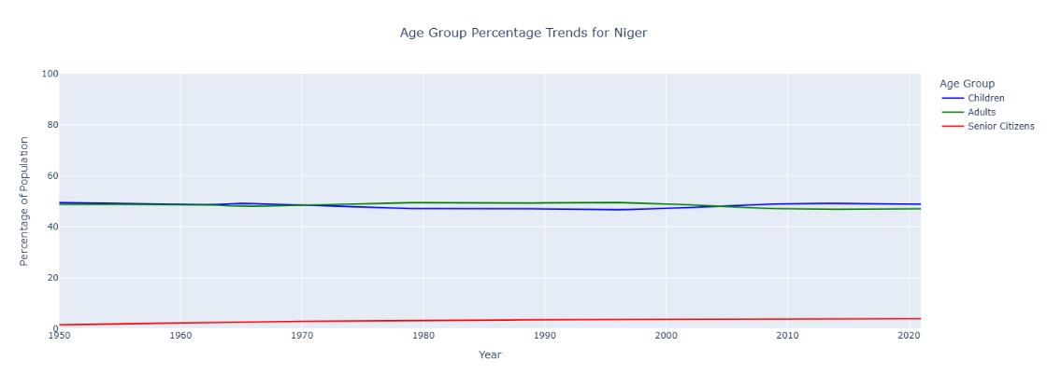
Niger and Similar Countries (Palestine, Marshall Islands):
Characteristics: High percentage of children, moderate adult population
and a small percentage of senior citizens w.r.t other countries.
Effects: High dependency ratios strain resources like education, health, and food supply.
High youth population better Future.
Notes:
High percentage of children, moderate adult population
and a small percentage of senior citizens.
High dependency ratios strain resources like education, health, and food supply.
A youthful population creates opportunities for a future workforce, provided investments in education and skills development are made.
Economic challenges arise from balancing population growth and available resources.

Slide 12
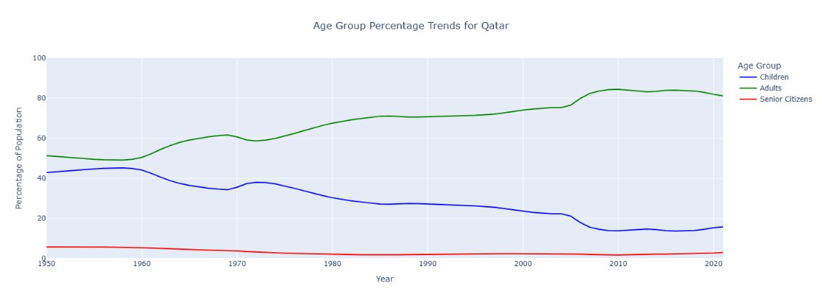
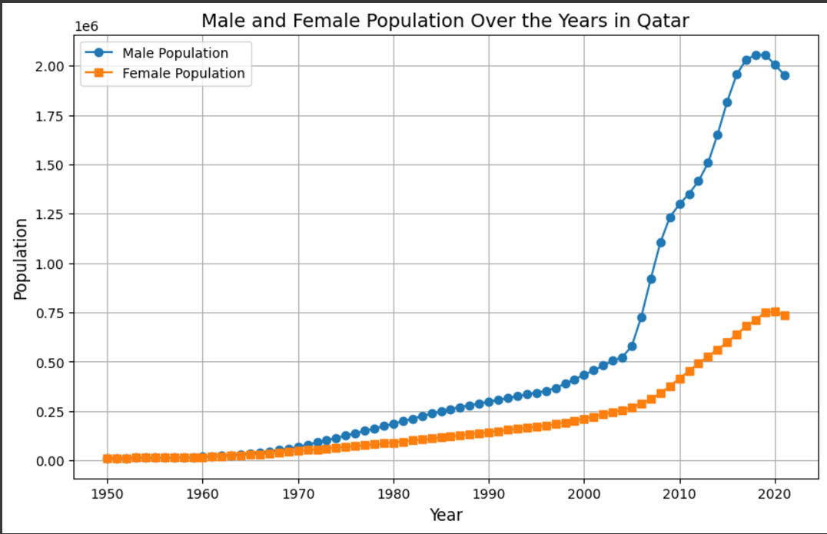
Qatar and Similar Countries (UAE, Singapore):
Characteristics: Predominantly adult population, low percentages of children and senior citizens w.r.t other countries .
Effects: High chances of population increase and solve the issue of low children.
Causes population imbalance.
Notes:
Qatar and Similar Countries (UAE, Singapore):
Characteristics: Predominantly adult population, low percentages of children and senior citizens.
Effects: High chances of population increase and solve the issue of low children.
Causes population imbalance.
Dependence on foreign workers: The economy and infrastructure heavily rely on workers from other countries.
Cultural and demographic challenges: It's difficult to blend different cultures and ensure the population stays balanced for future needs.
Fewer elderly people: Right now, there’s less spending on older adults, but plans are needed to handle an aging workforce in the future.

Slide 13

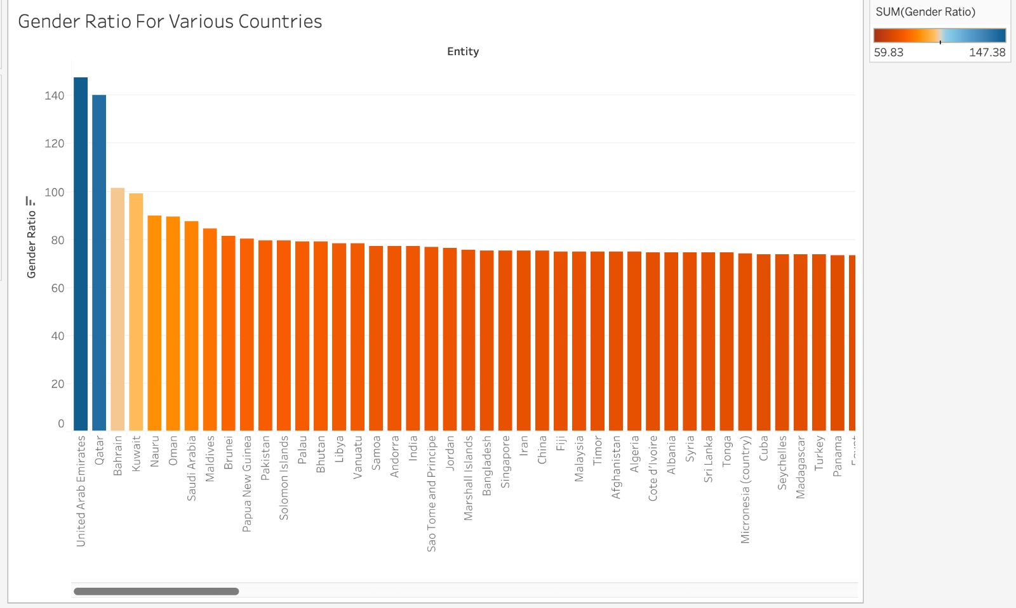



3: How do population demographics, such as gender imbalance ratio and birth estimates, vary across different countries and over time? ​
Bar Chart: Gender Ratio by Entity
Countries with the highest gender ratio could indicate societal or cultural factors affecting the male-to-female balance.
potential issues like workforce gaps, social instability, or marriage imbalances in countries with extreme gender ratios.

Slide 14
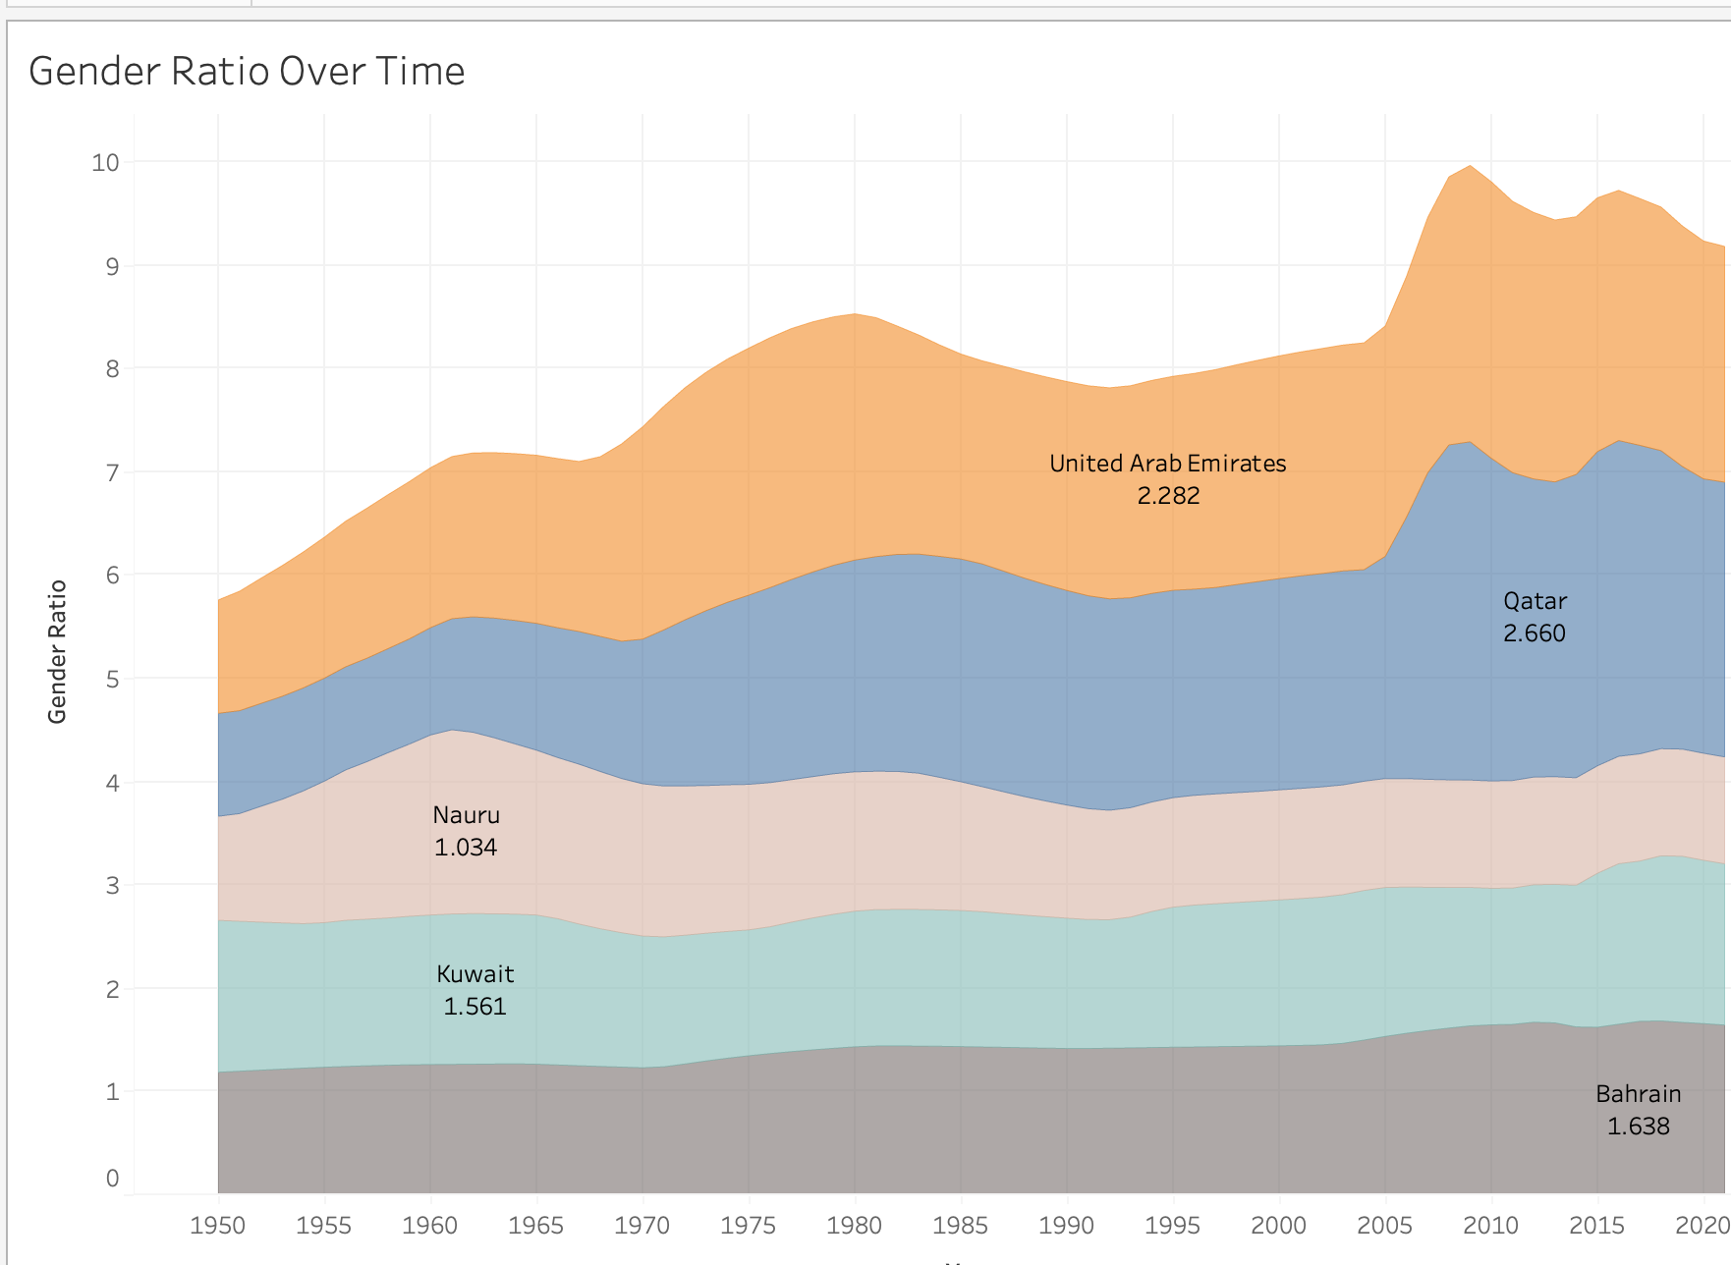
Area Chart: Gender Ratio Over Time
Long-term impacts: Predict future implications based on current trends, such as potential labor shortages or changes in family structures.

Slide 15
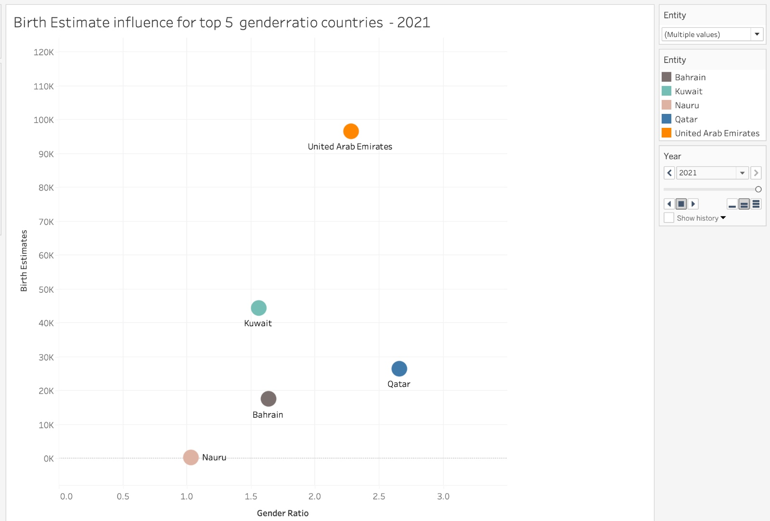
Scatter Plot: Gender Ratio Effect on Birth Estimates
Extreme gender imbalances might influence birth rates, possibly affecting future population growth and societal structure. an aging workforce in the future.

Slide 16
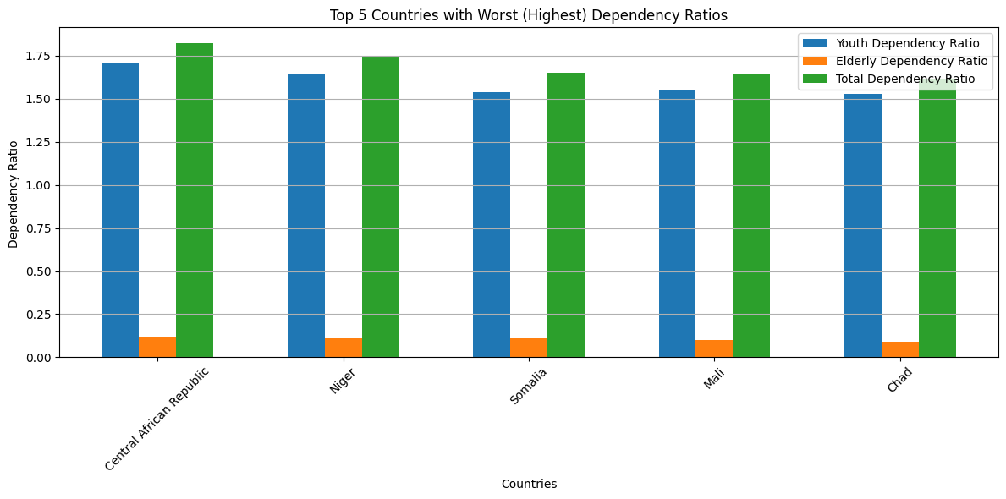
4.How do birth and death rates impact population growth, and what are the economic implications for countries with varying dependency ratios?

Slide 17
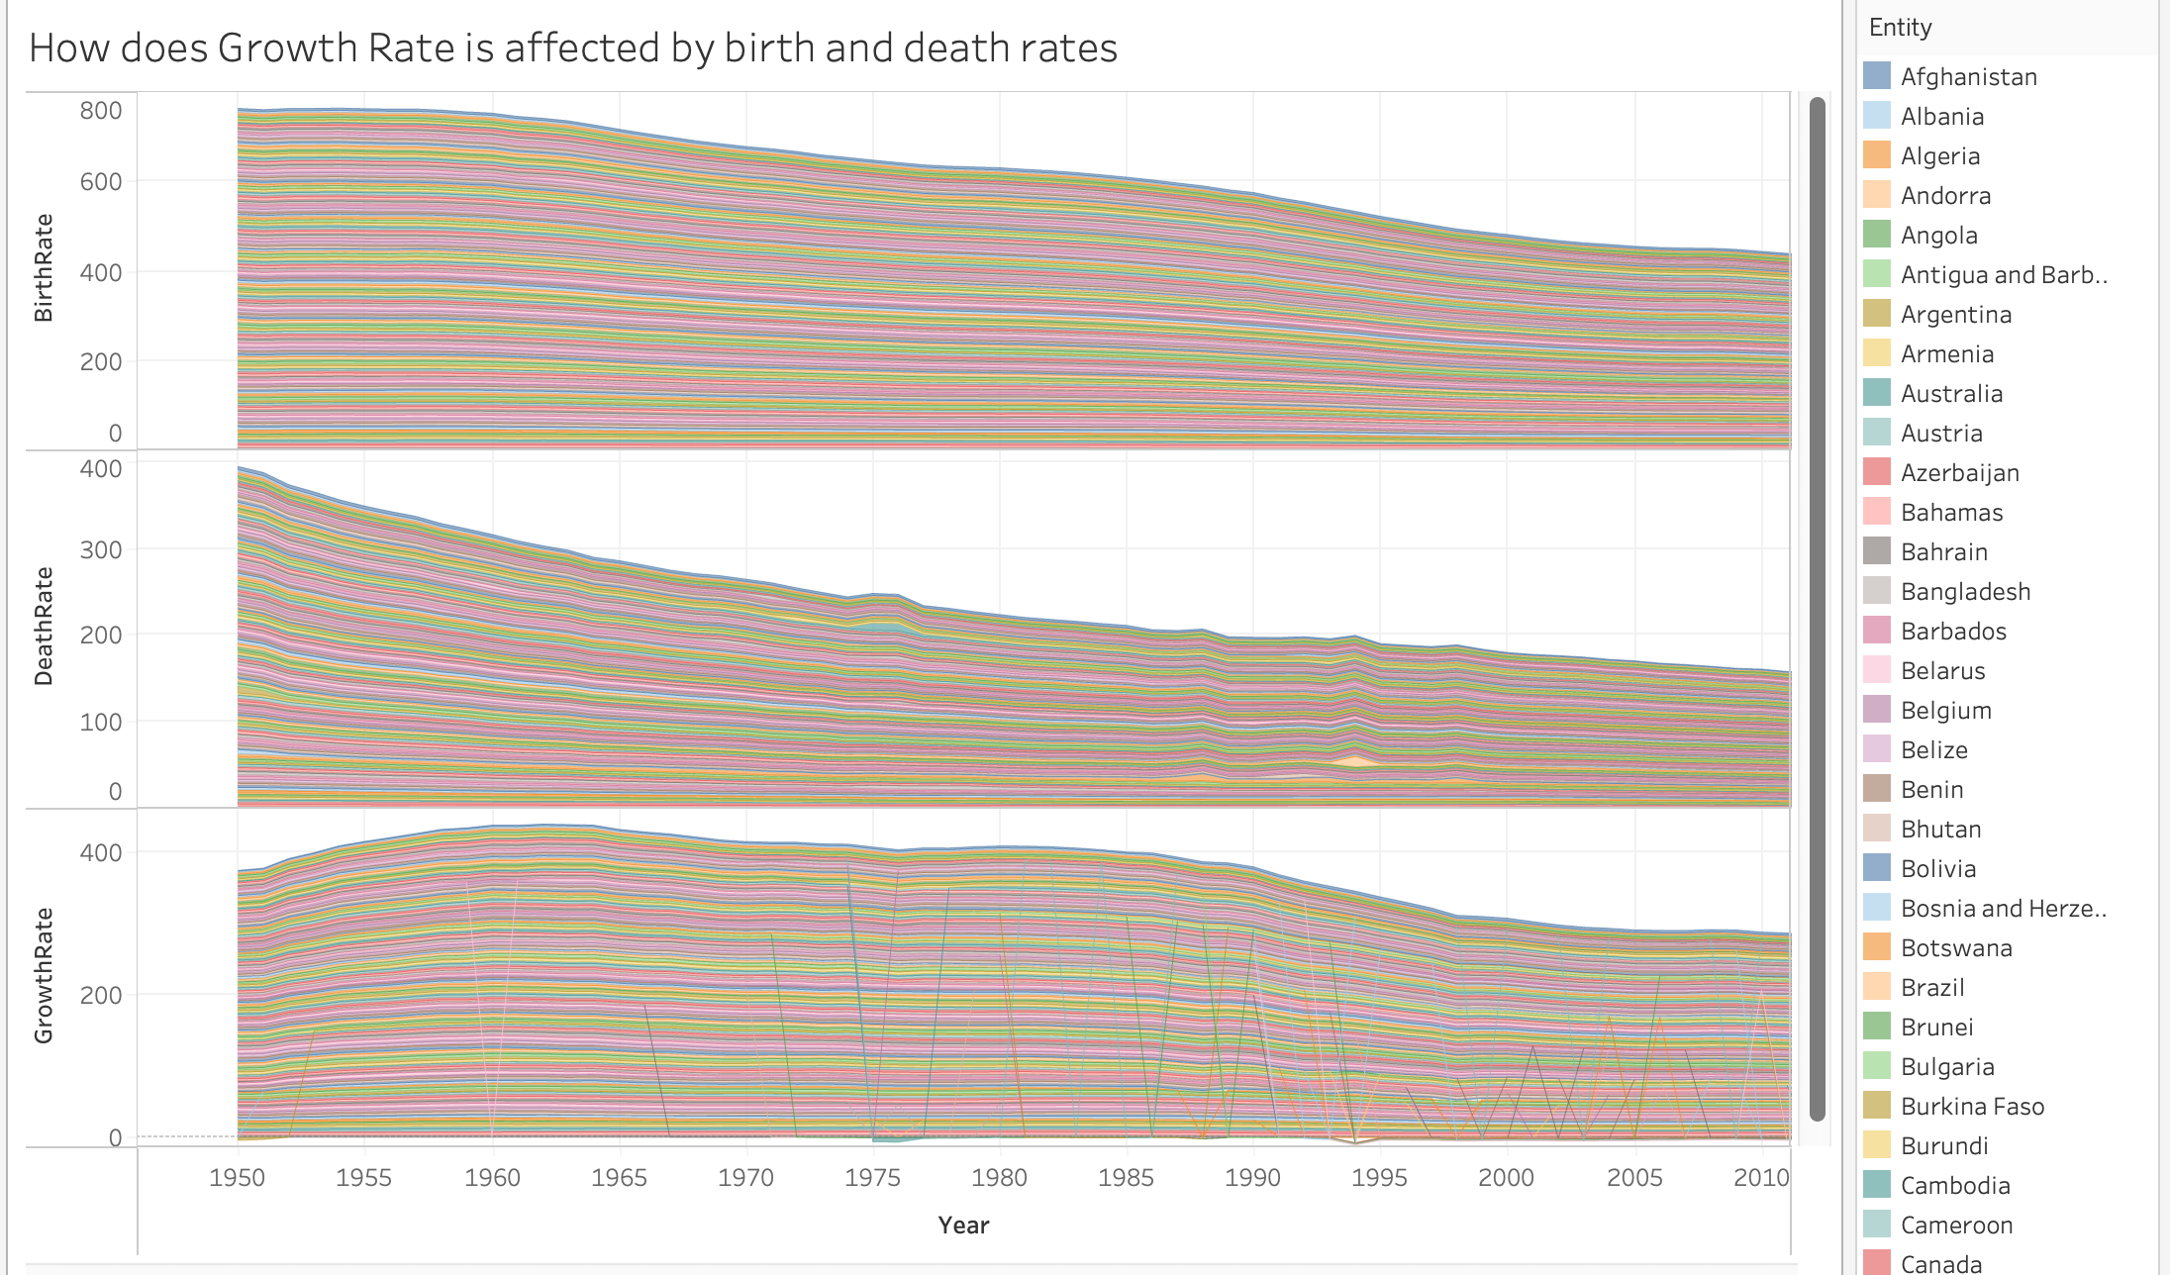

Slide 18
High Birth Rate + Low Death Rate:
Rapid population growth, leading to increased demand for education, healthcare, and infrastructure.
Economic opportunities but also potential challenges like overpopulation and resource strain.
Low Birth Rate + High Death Rate:
Population decline, affecting the workforce and economic growth.
Increased aging population, impacting pension systems and healthcare.
I

Slide 19
Conclusions
Rapid growth observed in developing countries like India and Nigeria, driven by high fertility rates and improved healthcare
Developed nations like Japan and parts of Europe show stagnation or decline due to aging populations and low birth rates.
Diverse age distributions highlight youth-driven populations in Africa, adult-dominated Gulf countries, and aging societies in developed nations.
Countries with skewed gender imbalance ratios (e.g., UAE) face workforce and social stability challenges, underscoring the need for balanced migration and social policies.
High dependency ratios in developing nations indicate stress on resources, whereas lower ratios in developed regions suggest economic opportunities but potential labor shortages due to declining youth populations.

Slide 20
References:
Sabri, S.M.; Annuar, N.; Rahman, N.L.A.; Musairah, S.K.; Mutalib, H.A.; Subagja, I.K. Major Trends in Ageing Population Research: A Bibliometric Analysis from 2001 to 2021. Proceedings 2022, 82, 19. https://doi.org/10.3390/proceedings2022082019
https://www.un.org/en/global-issues/ageing
Kudo, S.; Mutisya, E.; Nagao, M. Population Aging: An Emerging Research Agenda for Sustainable Development. Soc. Sci. 2015, 4, 940-966. https://doi.org/10.3390/socsci4040940
https://gulfmigration.grc.net/publications/book_grm2017/
https://www.un.org/development/desa/pd/sites/www.un.org.development.desa.pd/files/undesa_pd_2024_wpa2023-report.pdf

Slide 21


.
Thank you.

